Slide 1
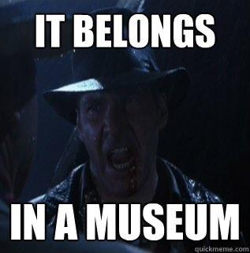
Machine learning belongs in a museum!

Slide 2





Microsoft MVP.
Client Partner at Geneca.
Spend time with family, movies, videogames, soccer.
@thesoccerdev
drkclw
samueljgomez

Slide 3

Agenda
Project overview.
What did we do?
Tool overview.
Lessons learned.

Slide 4

Project overview.

Slide 5
The objective.
Build a process backed by a machine learning model that maintains temperature and humidity conditions in museum spaces while minimizing energy consumption.
Notes:
Speak about the motivations: money, environment, keeping museum pieces safe

Slide 6
Why do it?
Reduce carbon footprint.
Save money.
Keep museum pieces safe.

Slide 7
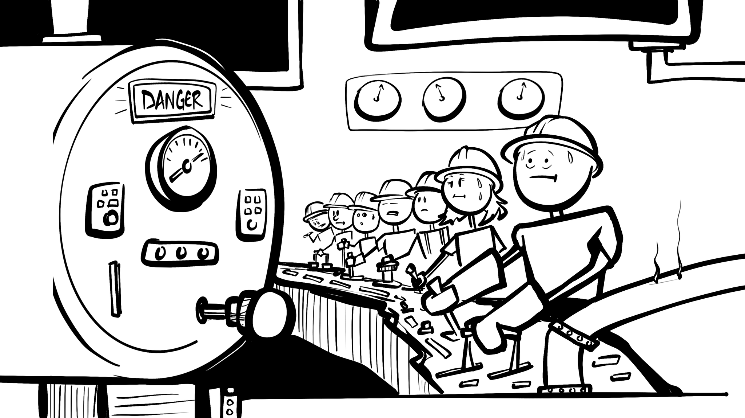
Notes:
Talk about how it worked before the models: The building engineers controlling temperature

Slide 8
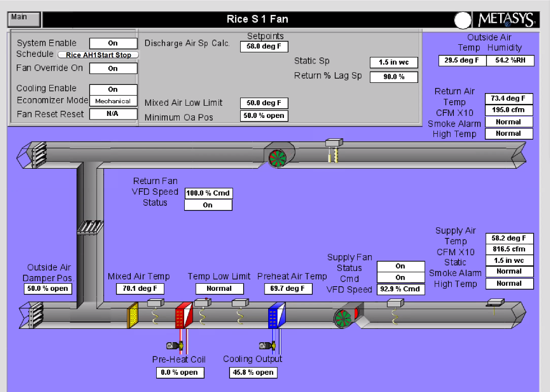
Meet the air handler.
Notes:
Heat in gallery as well

Slide 9
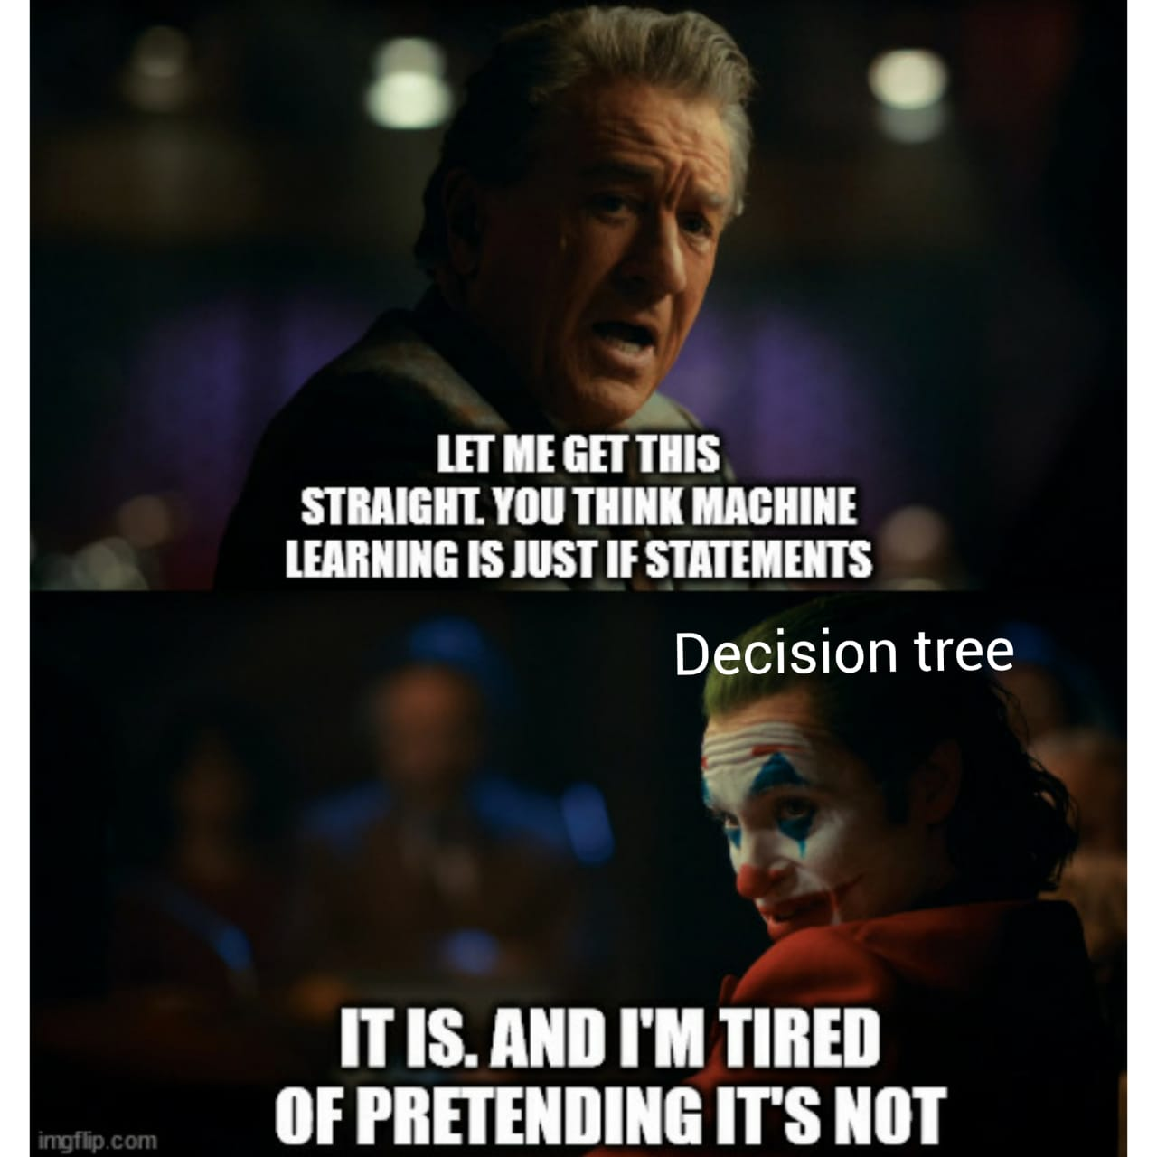

Slide 10
Glossary of terms.
Discharge Air Temperature (DA-T).
Discharge Air Humidity (DA-H).
Humidity (room).

Slide 11
What did we do?

Slide 12
Evaluate existing process.

Slide 13
Improvements required.
Improved models with more features.
Separate processes for each airhandler.
Gradual temperature increase.
Improved logging.
Reporting.

Slide 14
Challenges to consider.
Data access.
Data point names not standardized.
Sensor data every 5 minutes.

Slide 15
Improved models

Slide 16
Predicting DA-T.
DA-T
Ticket Data
OA-H
OA-T
OA-CFM
RA-T
RA-H
CO2
ZONE-HUMIDITY
SF-SPD
Month
Time
Wetbulb
Day of the week

Slide 17
Issues with predicting DA-T.
Big temperature changes.
Some features not needed.
Too conservative.

Slide 18
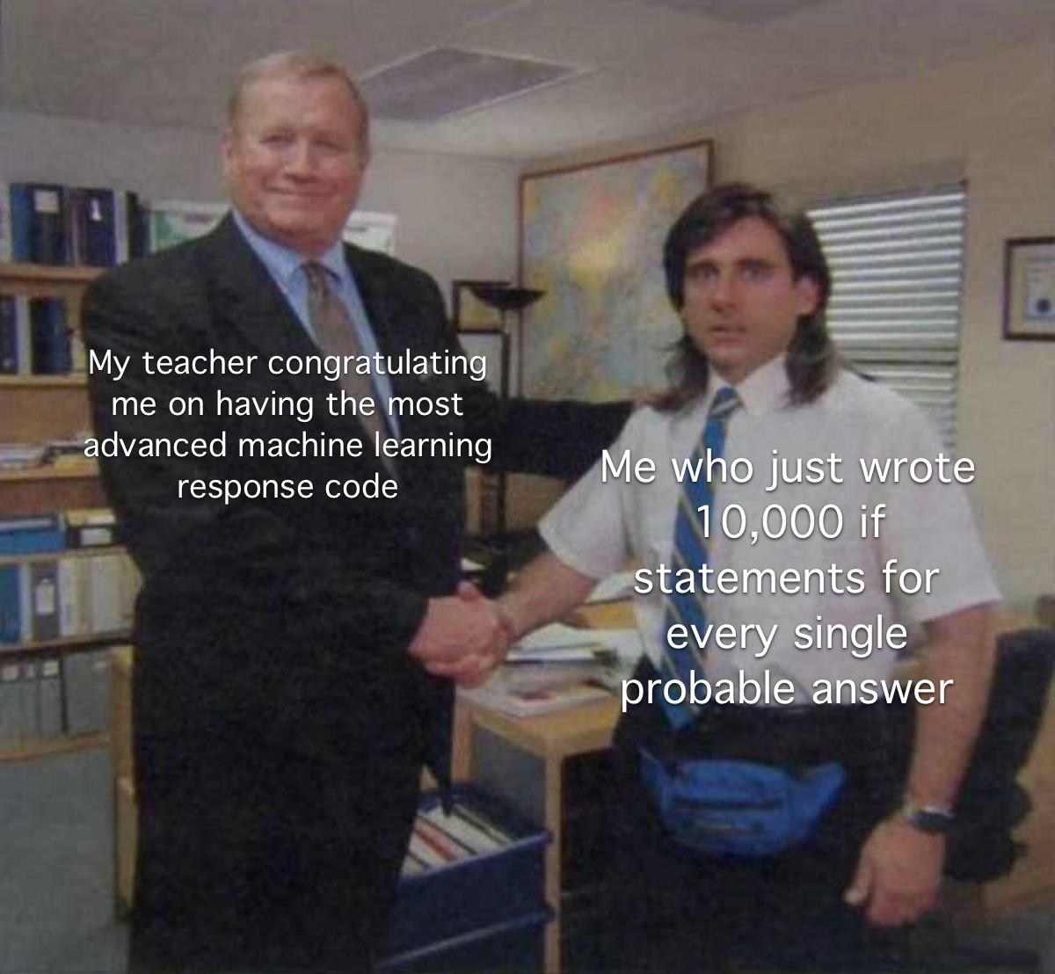

Slide 19
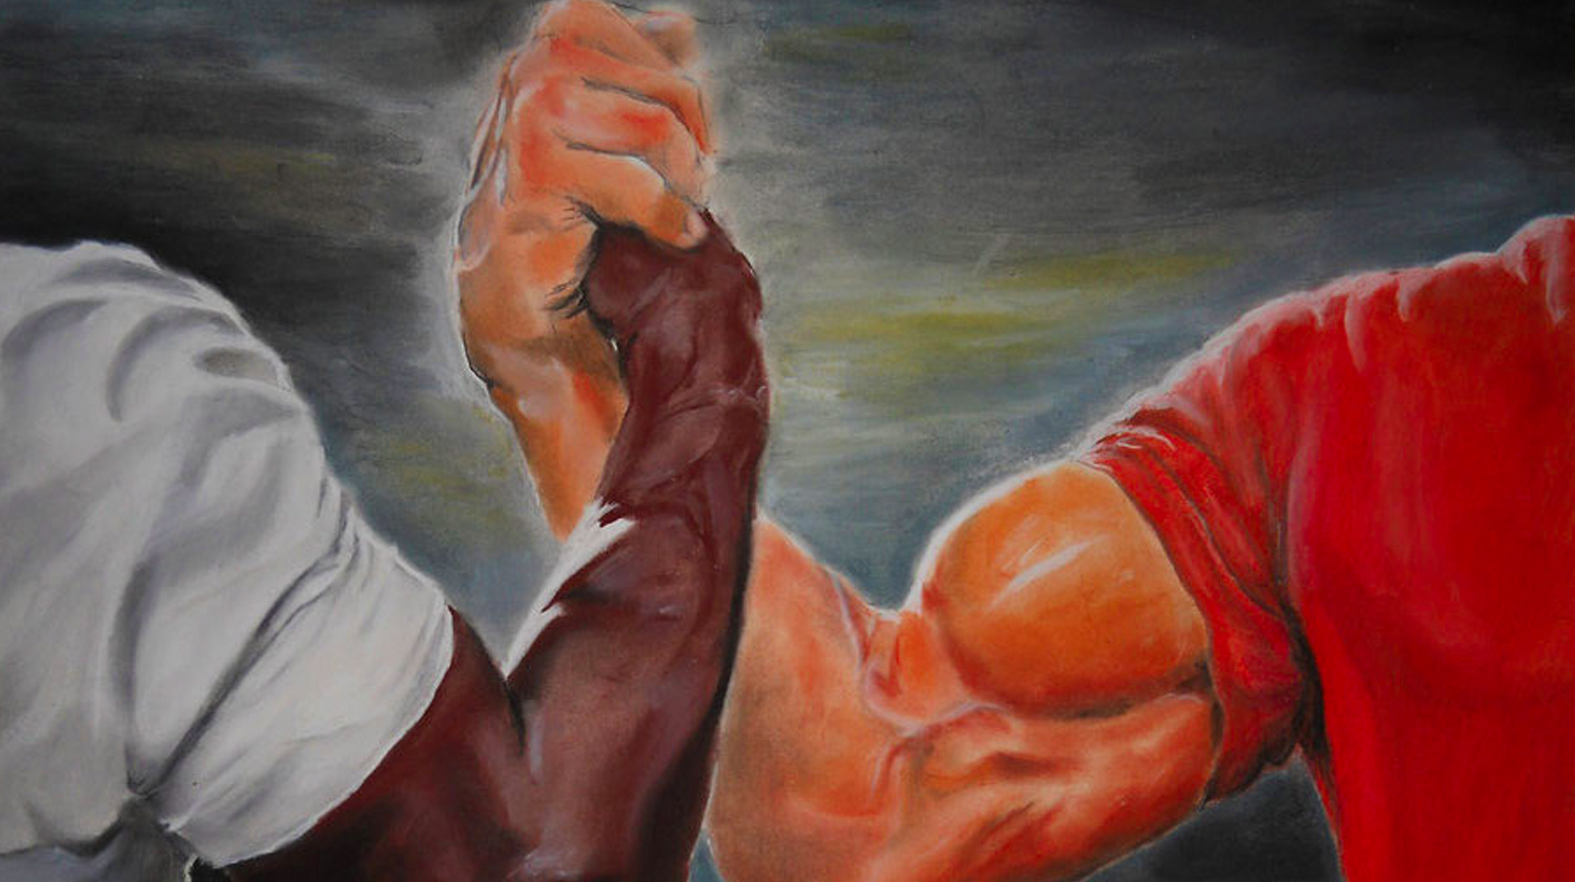
Predicting humidity.
SA-H
Humidity

Slide 20
Predicting humidity.
DA-H
RA-H
DA-T
Humidity
DA-T
CO2
Wetbulb
SF-SPD
HUM-V
RA-H
Wetbulb
SF-SPD

Slide 22
Separate processes

Slide 23
Azure functions for the win!
One Azure function per airhandler.
Specific logic per airhandler (temp and humidity threshold, calculations, etc).
Logging different conditions.
Missing data.
Warmup vs cool down.
What caused the warmup vs cool down.
Resulting DA-T.

Slide 25
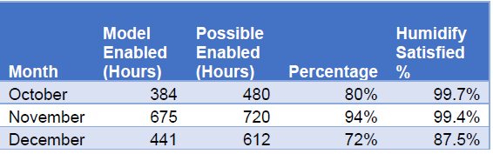
Museum 1 air handler summary.

Slide 26
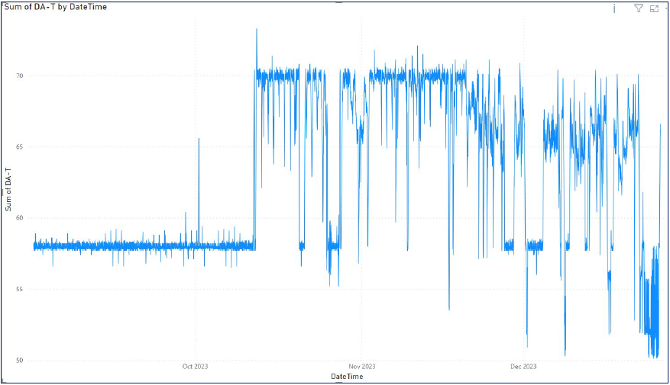
DA-T graph.

Slide 27
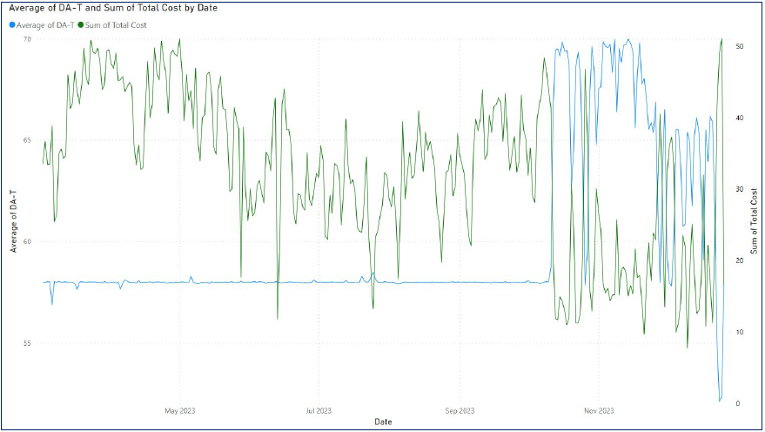
DA-T vs Total operating cost.

Slide 28
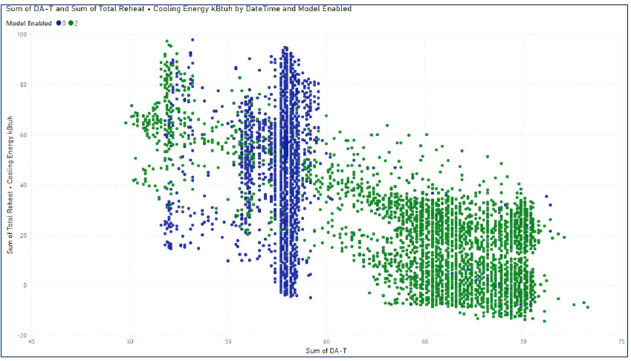
DA-T vs energy usage.

Slide 29
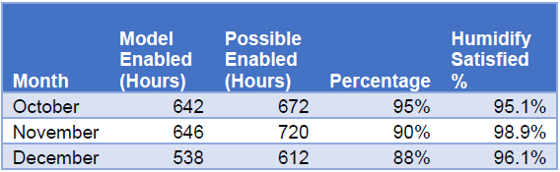
Museum 2 air handler summary.

Slide 30
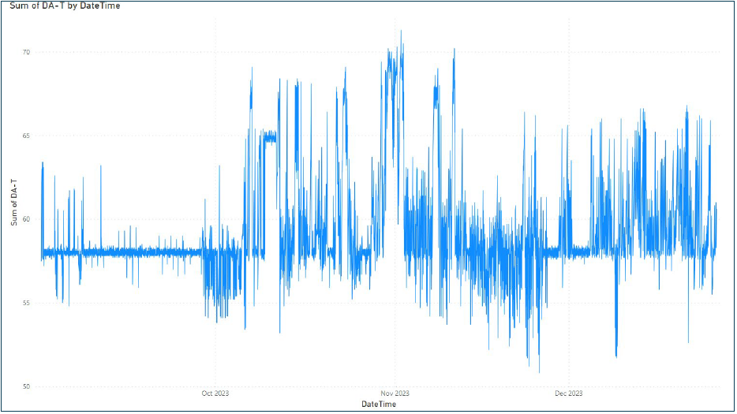
DA-T graph.

Slide 31
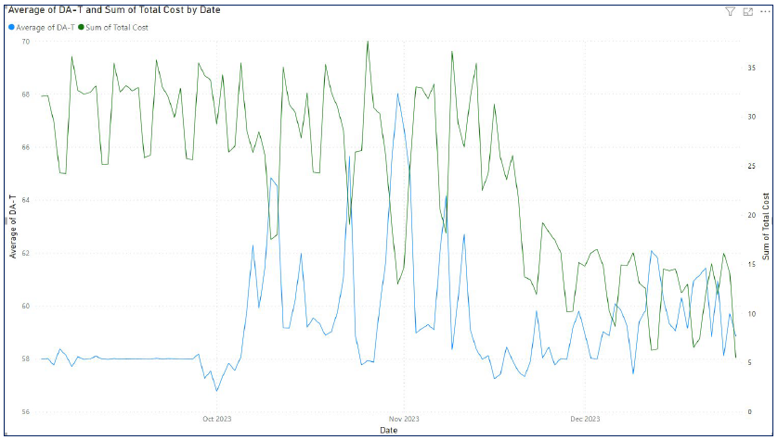
DA-T vs Total operating cost.

Slide 32
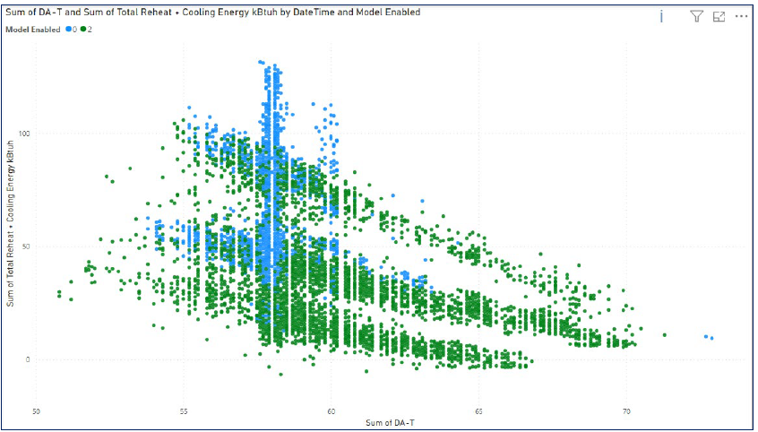
DA-T vs energy usage.

Slide 33
Tool overview

Slide 34
Azure Iot Hub

Slide 35
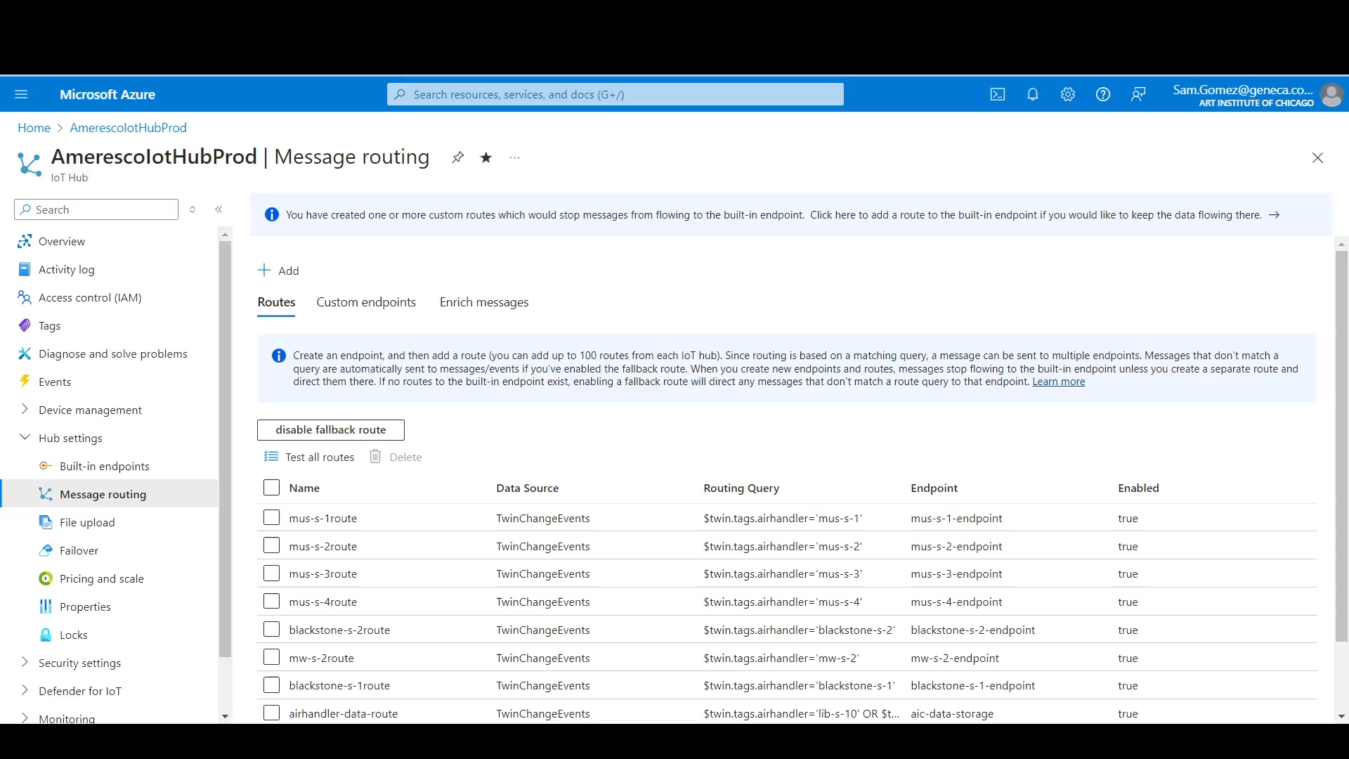

Slide 36
Azure Machine Learning Studio

Slide 37
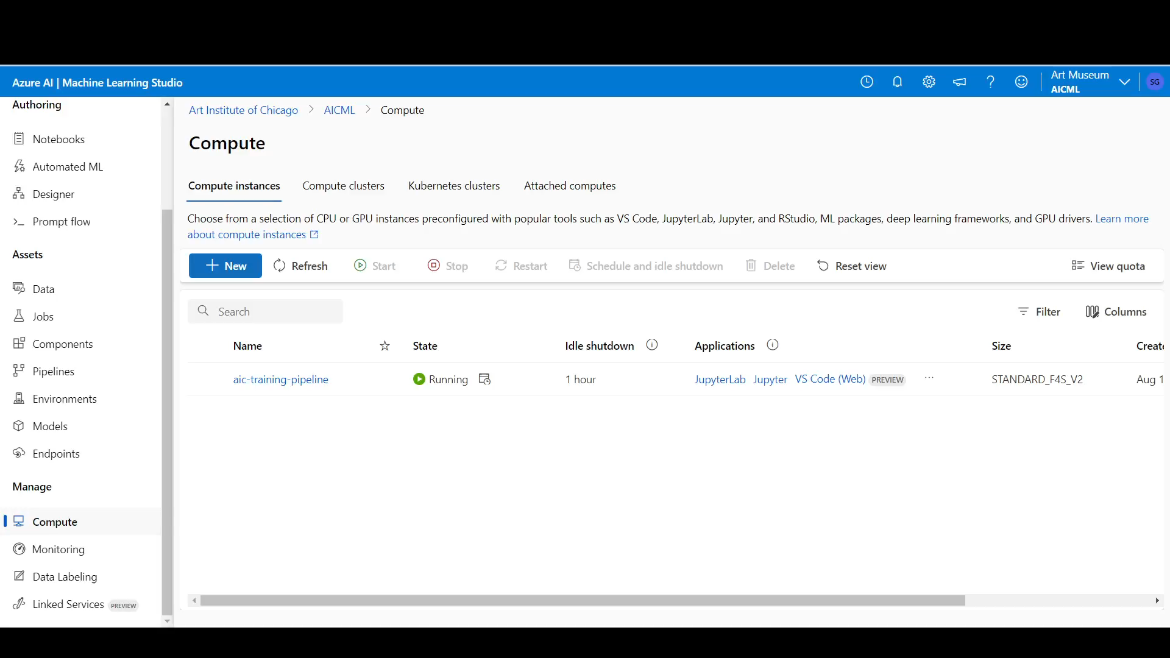

Slide 38
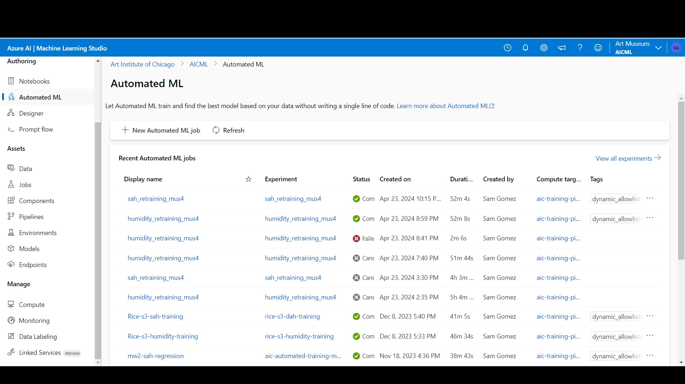

Slide 39
Microsoft Fabric

Slide 40
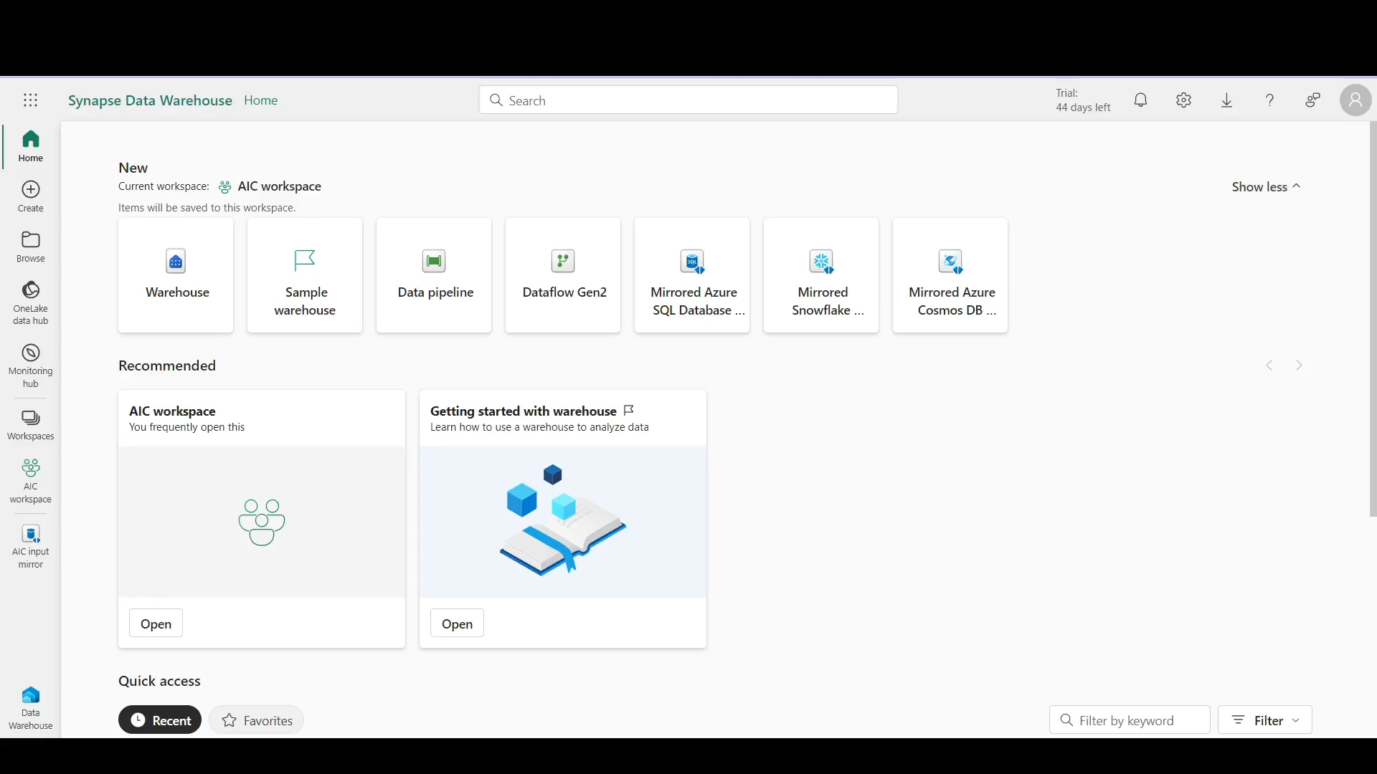

Slide 41
What did we learn?

Slide 42
Stakeholders are key.
Champion the project.
ML project deliverables vs traditional software project deliverables.
Notes:
Talk about the difference it made to have someone to champion the project

Slide 43
Define clear goals.
What is success?
“Reduce energy consumption by 5%”.
Notes:
Talk about setting specific objective (for example, 10% savings)

Slide 44
Know your data.
Accelerate development.
Faster troubleshooting.

Slide 45
Evaluate devices.
Determine differences sooner.
1
Minimize changes down the road.
2
Identify potential gaps or issues.
3

Slide 46
Be responsible.
Not everyone will be excited.
Keep humans in the loop.
Apply safeguards.

Slide 47
Useful links.
https://learn.microsoft.com/en-us/azure/iot-hub/
https://learn.microsoft.com/en-us/azure/machine-learning/?view=azureml-api-2
https://learn.microsoft.com/en-us/fabric/

Slide 48
@thesoccerdev
drkclw
samueljgomez

